Slide 1
Chapter 8: Main Memory

Slide 2
Chapter 8: Memory Management
8.1 Background
8.2 Swapping （交换）
8.3 Contiguous Memory Allocation （连续内存分配）
8.4 Paging （分页）
8.5 Segmentation （分段）
8.6 Segmentation with Paging （段页式）
8.7 Example: The Intel Pentium

Slide 3
Objectives
To provide a detailed description of various ways of organizing memory hardware
To discuss various memory-management techniques, including paging and segmentation
To provide a detailed description of the Intel Pentium, which supports both pure segmentation and segmentation with paging

Slide 4
8.1 Background

Slide 5
Background
Program must be brought (from disk) into memory and placed within a process for it to be run
Main memory and registers are only storage CPU can access directly
Register access in one CPU clock (or less)
Main memory can take many cycles
Cache sits between main memory and CPU registers
Protection of memory required to ensure correct operation

Slide 6
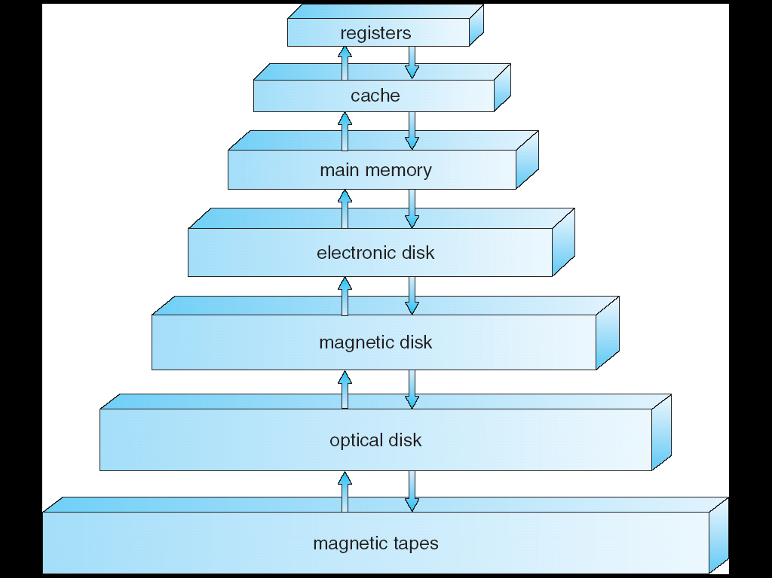
Hierarchical Storage Architecture
very fast
very small
volatile
Memory Management
non-volatile
filesystem manages non-volatile storage
very slow
very large

Slide 7
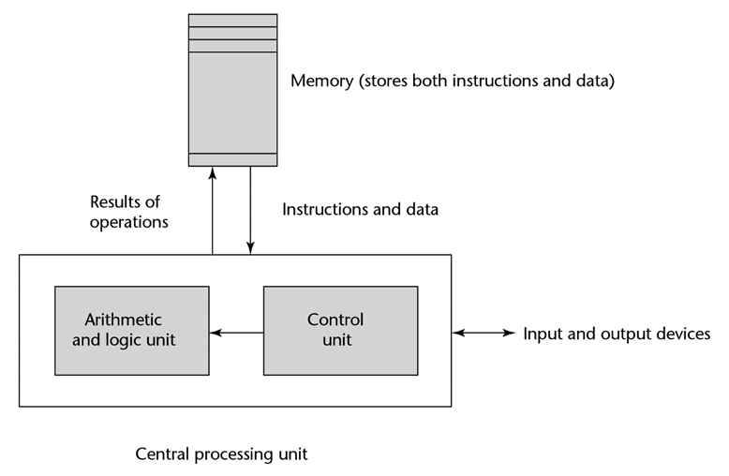
Main Memory
Based on the von Neumann architecture, data and program instructions exist in shared memory space
Repeatedly perform fetch-decode-execute cycles
The execute part often results in data fetch and store operations
physical memory

Slide 8
Logical vs. Physical Address Space
The concept of a logical address space that is bound to a separate physical address space is central to proper memory management
Logical address（逻辑地址，相对地址，虚地址）– generated by the CPU; also referred to as virtual address
用户的程序经过汇编或编译后形成目标代码，目标代码通常采用相对地址的形式。
其首地址为0，其余指令中的地址都相对于首地址来编址。
不能用逻辑地址在内存中读取信息。
Physical address （物理地址，绝对地址，实地址） – address seen by the memory unit
内存中存储单元的地址。物理地址可直接寻址

Slide 9
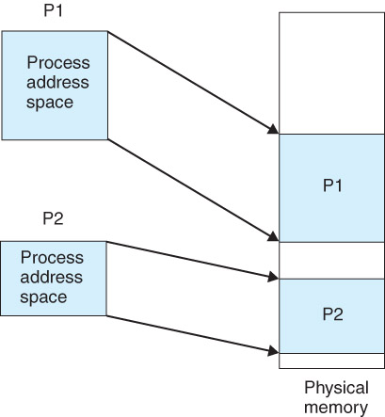
Logical vs. Physical Address Space

Slide 10
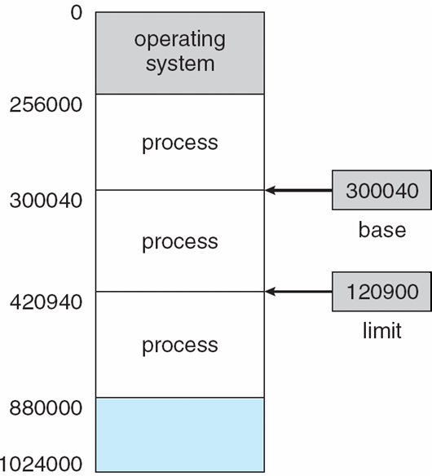
Base and Limit Registers
A pair of base and limit registers （基址寄存器和限长寄存器）define the logical address space

Slide 11
Binding of Instructions and Data to Memory
Address binding（地址绑定、地址映射、重定位） of instructions and data to memory addresses can happen at three different stages
Compile time: If memory location known a priori, absolute code can be generated; must recompile code if starting location changes
Load time: Must generate relocatable code if memory location is not known at compile time
Execution time: Binding delayed until run time if the process can be moved during its execution from one memory segment to another. Need hardware support for address maps (e.g., base and limit registers)

Slide 12
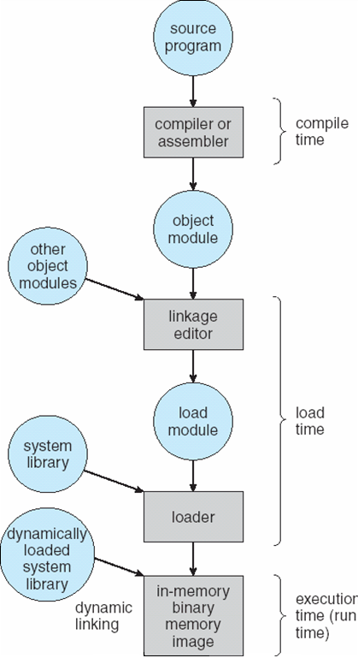
Multistep Processing of a User Program

Slide 13
Memory-Management Unit (MMU)
Hardware device that maps virtual to physical address
In MMU scheme, the value in the relocation register（重定位寄存器） is added to every address generated by a user process at the time it is sent to memory
The user program deals with logical addresses; it never sees the real physical addresses

Slide 14
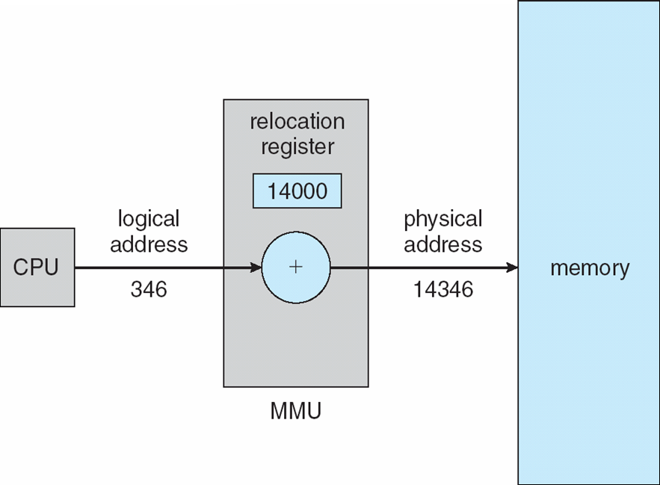
Dynamic relocation（动态重定位）

Slide 15
Dynamic Loading（动态转入）
Using dynamic loading, external libraries are not loaded when a process starts
Libraries are stored on disk in relocatable form
Libraries loaded into memory only when needed
Better memory-space utilization; unused routine is never loaded
Useful when large amounts of code are needed to handle infrequently occurring cases
No special support from the operating system is required implemented through program design

Slide 16
Dynamic Linking（动态链接）
Using dynamic linking, external libraries can be preloaded into (shared) memory
When a process calls a library function, the corresponding physical address is determined
Small piece of code, stub, used to locate the appropriate memory-resident library routine
Stub replaces itself with the address of the routine, and executes the routine
Operating system needed to check if routine is in processes’ memory address
Dynamic linking is particularly useful for libraries
System also known as shared libraries
Dynamically Linked Library 动态链接库

Slide 17
8.2 Swapping（交换技术）

Slide 18
Swapping（交换技术）
A process can be swapped temporarily out of memory to a backing store, and then brought back into memory for continued execution
Backing store – fast disk large enough to accommodate copies of all memory images for all users; must provide direct access to these memory images
Linux、UNIX—交换区
Windows—交换文件(pagefile.sys)
Roll out, roll in（调出，调进） – swapping variant used for priority-based scheduling algorithms; lower-priority process is swapped out so higher-priority process can be loaded and executed
Major part of swap time is transfer time; total transfer time is directly proportional to the amount of memory swapped
Modified versions of swapping are found on many systems (i.e., UNIX, Linux, and Windows)
System maintains a ready queue of ready-to-run processes which have memory images on disk

Slide 19
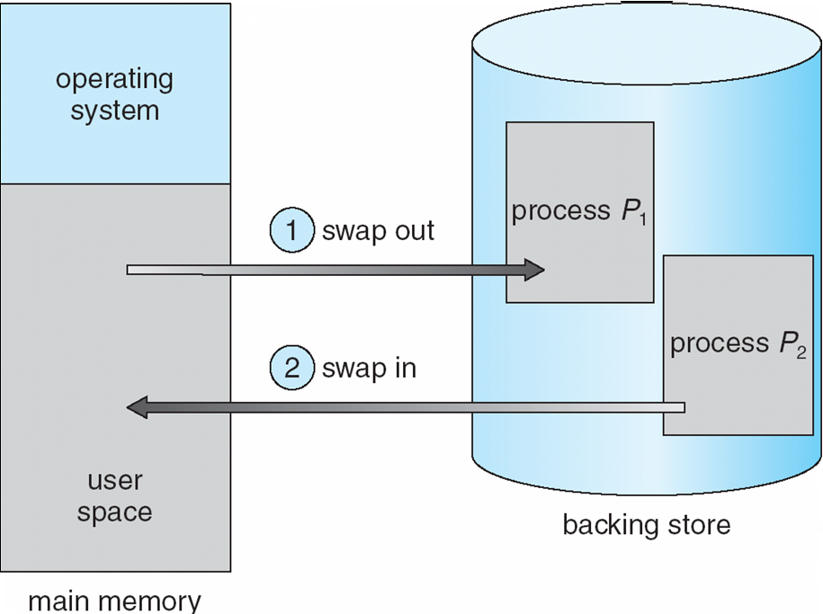
Schematic View of Swapping
requires dynamic relocation

Slide 20
Swapping (Cont.)
UNIX, Linux, and Windows：
正常情况下，禁止交换
当空闲内存低于某一个阈值时，启用交换换出
当空闲内存增加一定数量时，停止换出

Slide 21
Swapping on Mobile Systems
移动系统不支持交换，Flash memory based：
小空间
闪存写次数限制
在移动平台上闪存和CPU之间的吞吐量很低
iOS要求应用程序自愿放弃分配的内存
只读数据从系统中直接删除，已修改数据不会被删除
OS可以终止任何未能释放足够空间的应用
Android如果空闲内存不足，会终止应用程序，但首先会将应用程序状态写入闪存，以便快速重启

Slide 22
8.3 Contiguous Allocation（连续分配）

Slide 23
Contiguous Allocation（连续分配）
Main memory usually into two partitions(分区):
Resident operating system, usually held in low memory with interrupt vector
User processes then held in high memory
Relocation registers used to protect user processes from each other, and from changing operating-system code and data
Base register contains value of smallest physical address
Limit register contains range of logical addresses – each logical address must be less than the limit register
MMU maps logical address dynamically

Slide 24

Hardware Support for Relocation and Limit Registers

Slide 25
Contiguous Allocation (Cont.)
Multiple-partition allocation （多分区分配）
分区式管理的基本思想是将内存划分成若干个连续区域，称为分区。每个分区只能存放一个进程。
fixed partitioning（固定分区）
Dynamic Partitions（动态分区）

Slide 26
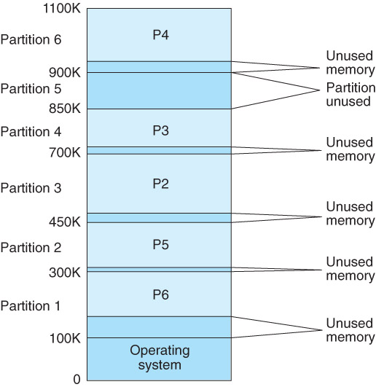
Contiguous Allocation (Cont.)
一、fixed partitioning（固定分区）
Main memory is partitioned and allocated to the resident operating system and processes
fixed partitioning scheme

Slide 27

Contiguous Allocation (Cont)
二、 Dynamic Partitions（动态分区）
动态划分内存，在程序装入内存时把可用内存“切出”一个连续的区域分配给该进程，且分区大小正好适合进程的需要。
Operating system maintains information about:
allocated partitions （已分配的分区）
free partitions (hole) （空闲的分区）
operating system maintains allocated partitions and free partitions
OS
OS
OS
OS
process 5
process 5
process 5
process 5
process 9
process 9
process 8
process 10
process 2
process 2
process 2
process 2

Slide 28
Dynamic Storage-Allocation Problem
How to satisfy a request of size n from a list of free holes
First-fit: Allocate the first hole that is big enough
Best-fit: Allocate the smallest hole that is big enough; must search entire list, unless ordered by size
Produces the smallest leftover hole
Worst-fit: Allocate the largest hole; must also search entire list
Produces the largest leftover hole
First-fit and best-fit better than worst-fit in terms of speed and storage utilization

Slide 29
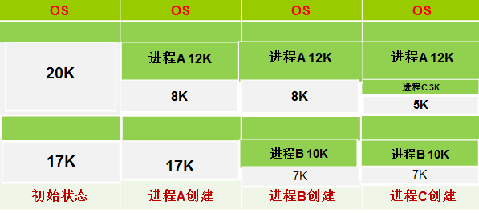
Dynamic Storage-Allocation Problem
1. First-fit(首次适应): Allocate the first hole that is big enough.
设进程创建顺序： A：12K， B：10K ，C： 3K

Slide 30
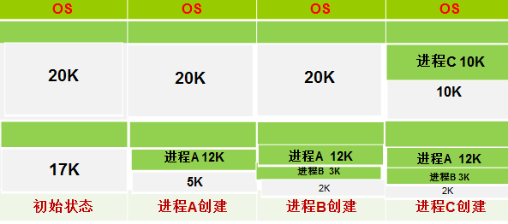
Dynamic Storage-Allocation
2. Best-fit（最佳适应）: Allocate the smallest hole that is big enough; must search entire list, unless ordered by size. Produces the smallest leftover hole
进程创建顺序： A：12K ，B： 3K ，C： 10K

Slide 31
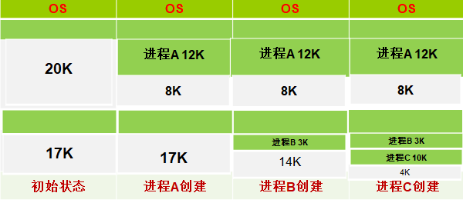
Dynamic Storage-Allocation
3. Worst-fit （最差适应） : Allocate the largest hole; must also search entire list. Produces the largest leftover hole.
进程创建顺序： A：12K， B：3K， C：10K

Slide 32
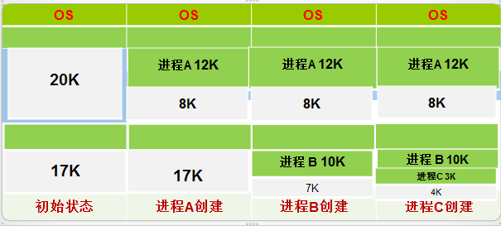
Dynamic Storage-Allocation
4. Next Fit（下次适应）：类似首次适应，每次分区时，总是从上次查找结束的地方开始，只要找到一 个足够大的空白区，就把它划分后分配出去。
进程创建顺序： A：12K， B：10K， C： 3K
Demo

Slide 33

Fragmentation
Memory is wasted due to fragmentation, which can cause performance problems
Internal fragmentation (内碎片、内零头) is wasted memory within a single process memory space
External fragmentation（外碎片、外零头）can reduce the number of runnable processes
Total memory space exists to satisfy a request, but memory is not contiguous
OS
Process 5
Process 8
unused
Process 2
Process 3
Process 6
Process 9
Process 7
Process 12

Slide 34
Fragmentation
OS
Reduce external fragmentation by compaction or defragmentation （紧缩，拼接）
Rearrange memory contents to organize all free memory blocks together in one large block
Compaction is possible only if relocation is dynamic and is done at execution time
Process 5
Process 8
Process 2
Process 3
Process 3
Process 6
Process 6
Process 7
Process 9
Process 12
Process 7
Process 9
Process 12
defragmentation is expensive

Slide 35
8.4 Paging（分页，页式存储管理）

Slide 36
Paging
Physical address space of a process can be noncontiguous; process is allocated physical memory whenever the latter is available
Divide physical memory into fixed-sized blocks called frames(帧、物理块、页框) (size is power of 2, between 512 bytes and 8,192 bytes)
Linux 、Windows for x86: 4K
Divide logical memory into blocks of same size called pages（页）
Keep track of all free frames
To run a program of size n pages, need to find n free frames and load program
Set up a page table（页表）to translate logical to physical addresses
page table列出了进程的逻辑页与其在主存中的物理帧间的对应关系
Internal fragmentation

Slide 37
Noncontiguous Allocation
When a process of size n pages is ready to execute, operating system finds n free frames
Operating system keeps track of pages via a page table
causes internal fragmentation
process P_{i}
== in use
main memory
== free

Slide 38
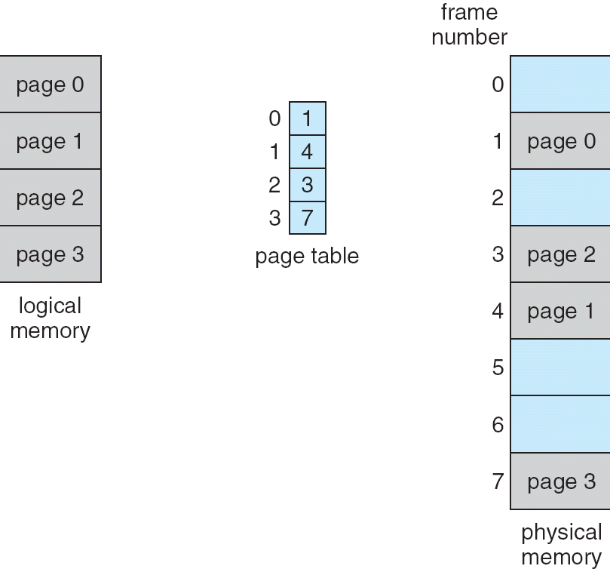
Paging Model of Logical and Physical Memory
A page table maps logical memory addresses to physical memory addresses

Slide 39
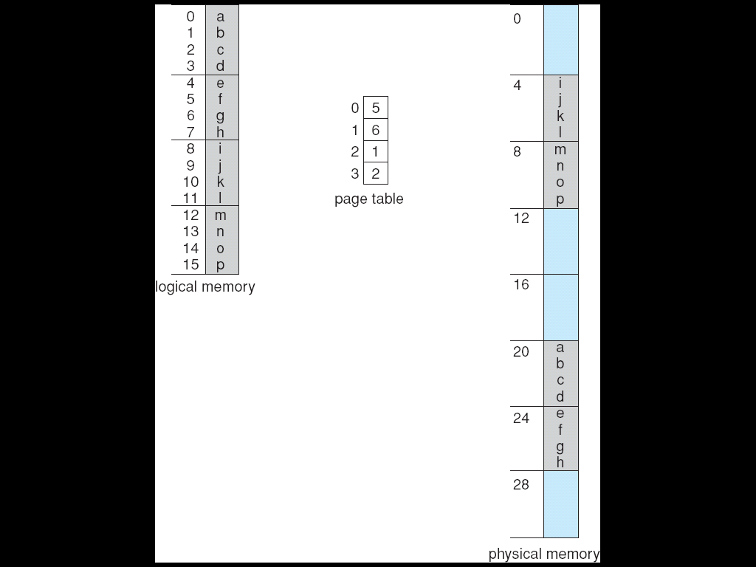

Paging Example
Example process P_{i} requires 16 bytes of logical memory
Logical memory is mapped via a page table to a 32-byte memory with pages of size 4 bytes
binary
0 ==> 000000
4 ==> 000100
8 ==> 001000
12 ==> 001100
16 ==> 010000
20 ==> 010100
24 ==> 011000
28 ==> 011100

Slide 40
Address Translation Scheme（地址变换）
Address generated by CPU is divided into:
Page number (p) （页号）– used as an index into a page table which contains base address of each page in physical memory
Page offset (d) （偏移）– combined with base address to define the physical memory address that is sent to the memory unit
For given logical address space 2^{m} and page size 2^{n}
page number
page offset
p
d
m - n
n

Slide 41
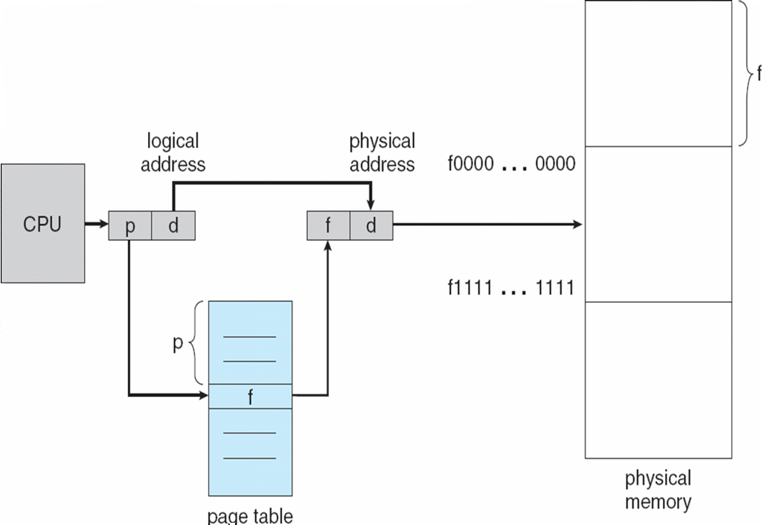
Paging Hardware
Frames = physical blocks
Pages = logical blocks
2
1
HARDWARE
An address is determined by:
page number ( index into table ) + offset
---> mapping into --->
base address ( from table ) + offset.

Slide 42
逻辑地址-物理地址转换
页面大小为4KB，虚地址2362H、1565H的物理地址分别是？页表如下
页号 | 页框 (Page Frame) 号
0 | 101H
1 | 102H
2 | 254H
2
1
Notes:
逻辑地址2362H对应的页号为2，254000H+362H。（4k=1000H）
逻辑地址1565H对应的页号为1，102000H+565H

Slide 43
Implementation of Page Table
Page table is kept in main memory
Page-table base register (PTBR) points to the page table， x86: cr3
Page-table length register (PTLR) indicates size of the page table
In this scheme every data/instruction access requires two memory accesses. One for the page table and one for the data/instruction.
The two memory access problem can be solved by the use of a special fast-lookup hardware cache called associative memory or translation look-aside buffers (TLBs) (联想寄存器、快表）
Some TLBs store address-space identifiers (ASIDs) in each TLB entry – uniquely identifies each process to provide address-space protection for that process

Slide 44
Associative Memory
Associative memory – parallel search
Address translation (p, d)
If p is in associative register, get frame # out
Otherwise get frame # from page table in memory
Page #
Frame #

Slide 45

Paging Hardware With TLB

Slide 46
Effective Access Time（有效访问时间）
Associative Lookup = ε time unit （快表访问时间）
Assume memory cycle time is t （内存访问时间）
Hit ratio（命中率） – percentage of times that a page number is found in the associative registers; ratio related to number of associative registers
Hit ratio = α
Effective Access Time (EAT)
EAT = (t+ε) α + ( t + t + ε) (1 – α)

Slide 47
Effective Access Time
Example： α(hit ratio) =80% , ε(TLB) =2ns, memory access time=100 ns
Effective Access Time (EAT)
EAT = (100 + 2)*0.8 + (100+100+2) *(1 – 0.8)
= 122 ns (nanoseconds，纳秒)
No associative registers
EAT=2*(memory access time)=100+100=200 ns
TLB时间忽略不计的情况:120ns

Slide 48
Memory Protection
Memory protection implemented by associating protection bit with each frame
Valid-invalid bit attached to each entry in the page table:
“valid” indicates that the associated page is in the process’ logical address space, and is thus a legal page
“invalid” indicates that the page is not in the process’ logical address space

Slide 49

Valid (v) or Invalid (i) Bit In A Page Table
Page-table length register (PTLR)

Slide 50
Shared Pages
Shared code
One copy of read-only (reentrant) code shared among processes (i.e., text editors, compilers, window systems).
Shared code must appear in same location in the logical address space of all processes
Private code and data
Each process keeps a separate copy of the code and data
The pages for the private code and data can appear anywhere in the logical address space
Reentrant Code(重入代码)、 Pure Code(纯代码)

Slide 51
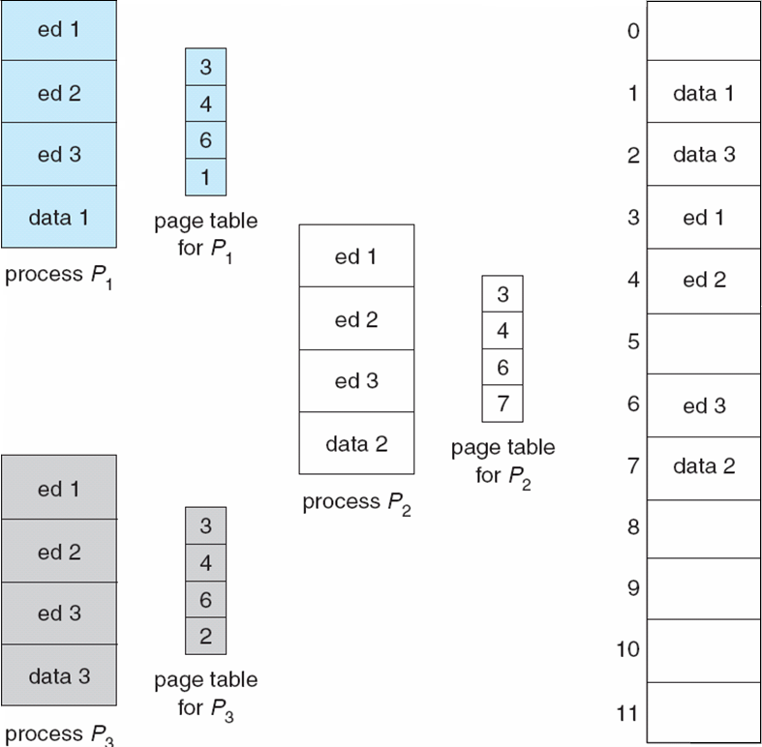
Shared Pages Example

Slide 52
Structure of the Page Table
1. Hierarchical Paging 分级页表
2. Hashed Page Tables 哈希页表
3. Inverted Page Tables 反向(反置)页表

Slide 53
1. Hierarchical Page Tables
x86的逻辑地址空间有2³²Byte，如页面大小为4KB（2¹²Byte），则页表项最多有1M（2²⁰）个，每个页表项占用4Byte，故每个进程的页表占用4MB内存空间，还要求是连续的，显然这是不现实的。
Break up the logical address space into multiple page tables
A simple technique is a two-level page table
Linux： four-level page table
Windows：two-level page table

Slide 54
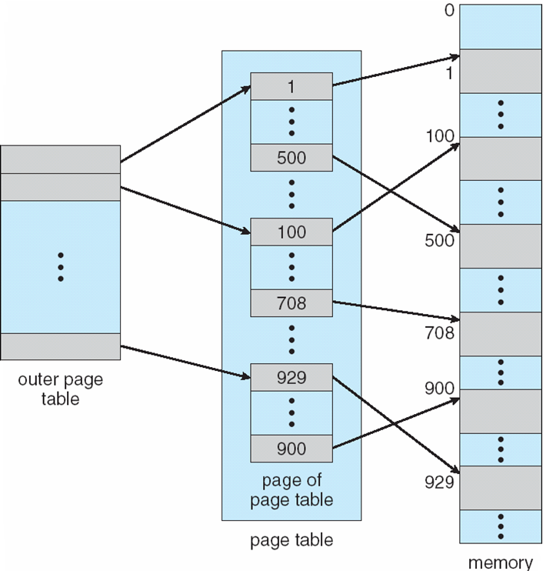
Two-Level Page-Table Scheme

Slide 55
Two-Level Paging Example
A logical address (on 32-bit machine with 4K page size) is divided into:
a page number consisting of 20 bits
a page offset consisting of 12 bits
Since the page table is paged, the page number is further divided into:
a 10-bit page number
a 10-bit page offset
Thus, a logical address is as follows:
where p₁ is an index into the outer page table, and p₂ is the displacement within the page of the page table
page number
page offset
p_{i}
p₂
d
10
10
12

Slide 56

Address-Translation Scheme

Slide 57


Three-level Paging Scheme

Slide 58
2. Hashed Page Tables
Common in address spaces > 32 bits
The virtual page number is hashed into a page table
This page table contains a chain of elements hashing to the same location
Virtual page numbers are compared in this chain searching for a match
If a match is found, the corresponding physical frame is extracted
例：SPARC Solaris (64位)

Slide 59

Hashed Page Table

Slide 60
3. Inverted Page Table
One entry for each real page of memory
Entry consists of the virtual address of the page stored in that real memory location, with information about the process that owns that page
Decreases memory needed to store each page table, but increases time needed to search the table when a page reference occurs
Use hash table to limit the search to one — or at most a few — page-table entries
例：UltraSPARC(64位) ，PowerPC (64位)

Slide 61

Inverted Page Table Architecture

Slide 62
8.5 Segmentation (分段，段式管理)

Slide 63
Segmentation
Memory-management scheme that supports user view of memory
A program is a collection of segments
A segment is a logical unit such as:
main program
procedure
function
method
object
local variables, global variables
common block
stack
symbol table
arrays

Slide 64
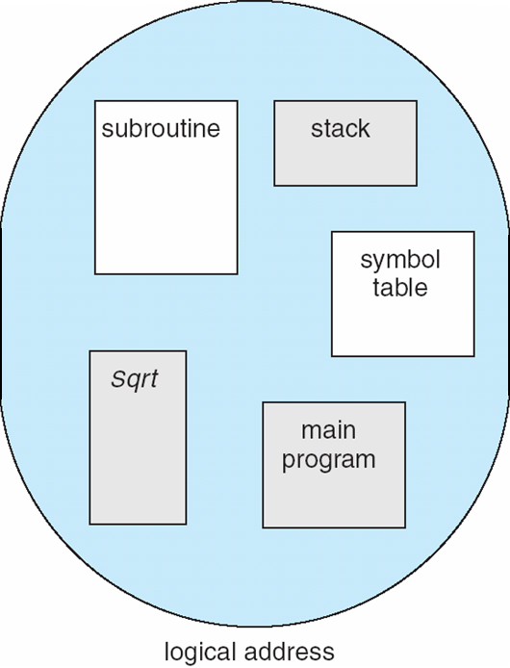
User’s View of a Program

Slide 65
Logical View of Segmentation
1
1
4
2
3
4
2
3
user space
physical memory space

Slide 66
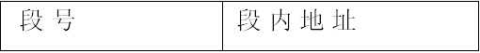
Segmentation Architecture
Logical address consists of a two tuple:
<segment-number, offset>,
Segment table （段表）– maps two-dimensional physical addresses; each table entry has:
base – contains the starting physical address where the segments reside in memory
limit – specifies the length of the segment
Segment-table base register (STBR) （段表基址寄存器）points to the segment table’s location in memory
Segment-table length register (STLR) （段表限长寄存器）indicates number of segments used by a program;
segment number s is legal if s < STLR
31 16 15 0

Slide 67
Segmentation Architecture (Cont.)
Protection
With each entry in segment table associate:
validation bit = 0 ⇒ illegal segment
read/write/execute privileges
Protection bits associated with segments; code sharing occurs at segment level
Since segments vary in length, memory allocation is a dynamic storage-allocation problem
A segmentation example is shown in the following diagram

Slide 68
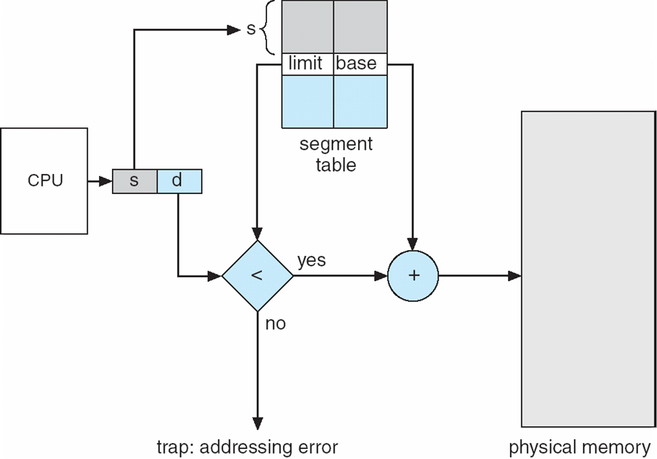
Segmentation Hardware

Slide 69
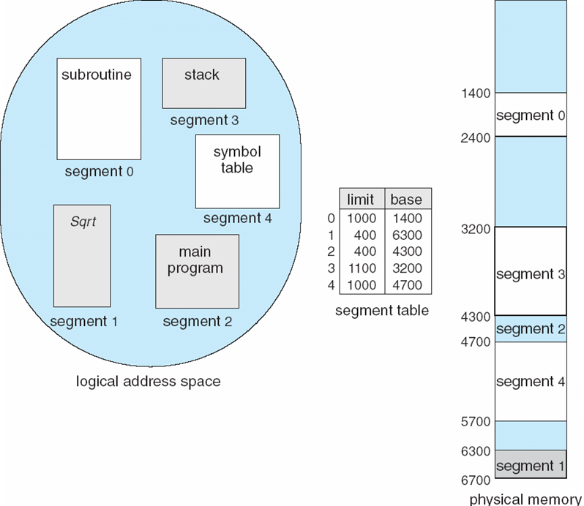
Example of Segmentation
（2，300）=〉4300+300
（3，852）=〉3200+852
（0，1222）=〉trap，addressing error

Slide 70
8.6 Example: The Intel Pentium

Slide 71
Example: The Intel Pentium
Supports both segmentation and segmentation with paging
CPU generates logical address
Given to segmentation unit
Which produces linear addresses
Linear address given to paging unit
Which generates physical address in main memory
Paging units form equivalent of MMU

Slide 72
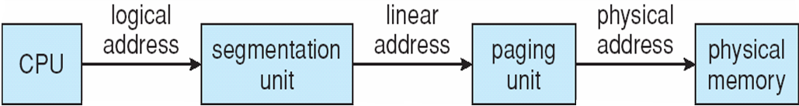
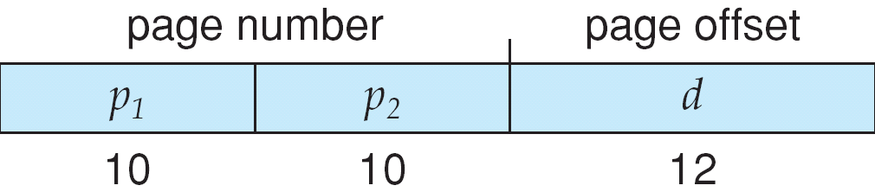
Logical to Physical Address Translation in Pentium

Slide 73
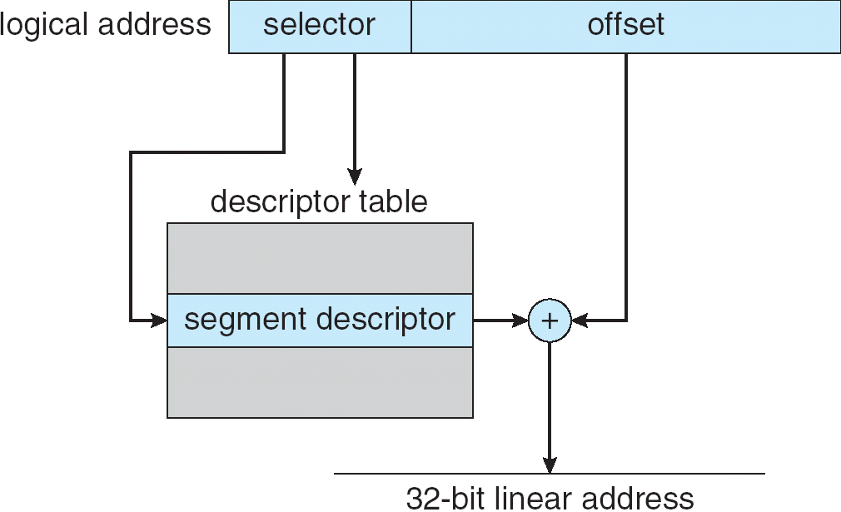
Intel Pentium Segmentation

Slide 74
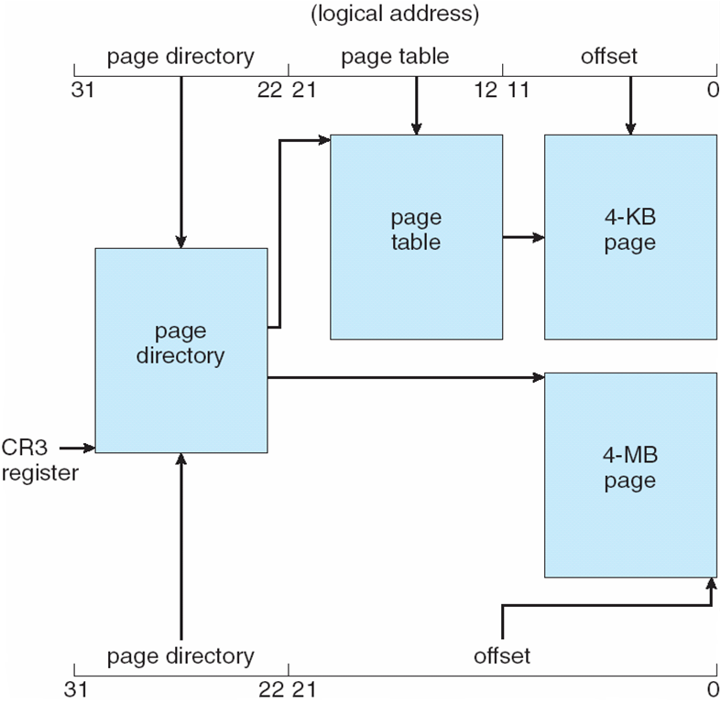
Pentium Paging Architecture

Slide 75

Linear Address in Linux
Broken into four parts:

Slide 76
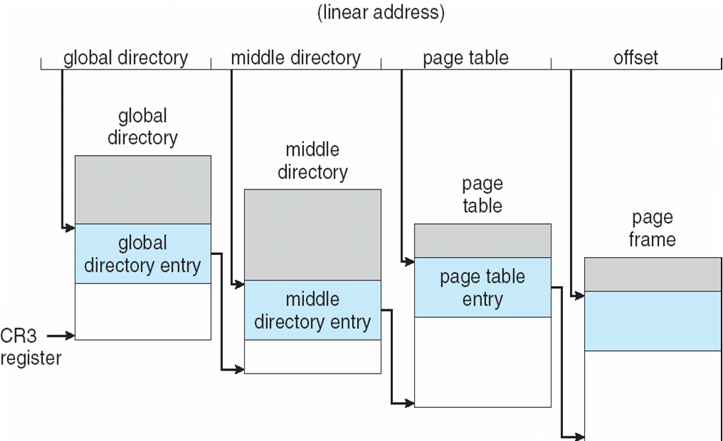
Three-level Paging in Linux

Slide 77
8.8 Summary

Slide 78
8.8 Summary
logical address, physical address
contiguous allocation
fixed-size partition
variable-size partition
first-fit, best-fit, worst-fit
paging
segmentation
segmentation with paging

Slide 79
Summary
Hardware support
Address Translation Scheme
Performance
translation look-aside buffer (TLB)
Fragmentation
internal fragmentation：
fixed-size partition
paging
segmentation with paging
external fragmentation：
variable-size partition
segmentation

Slide 80
Summary
relocation
compaction, save external fragmentation
require relocation at execution time
swapping
sharing
require paging or segmentation scheme
protection
protection bits on page table/segment table

Slide 81
本章内容
内存管理基本概念：源程序的常规处理流程，地址绑定，逻辑地址空间与物理地址空间；内存保护；MMU，动态加载，动态链接，交换，地址管理模型，模型指标。
交换与覆盖。
连续分配管理方式：单一连续分配算法，基地址寄存器，界限寄存器；动态分区管理，动态存储分配算法，外部碎片，内部碎片。
分页管理方式：页，页帧，页表，地址映射流程，硬件支持，页表实现，TLB，有效访问时间，页式管理的模型指标分析，页表结构，多级页表，哈希页表，反向页表。

Slide 82
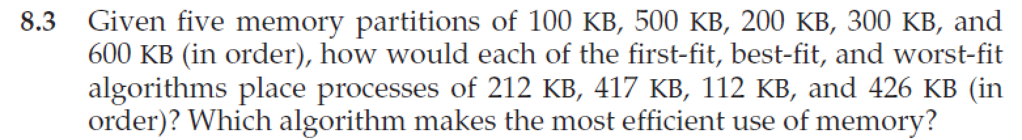
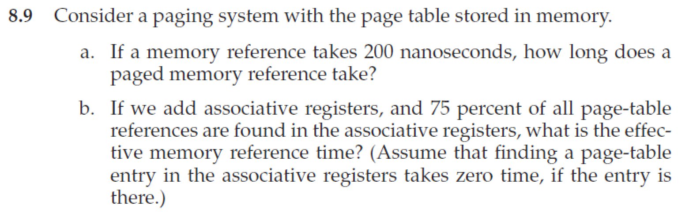
Homework
书后习题8.3、8.9、8.12

Slide 83
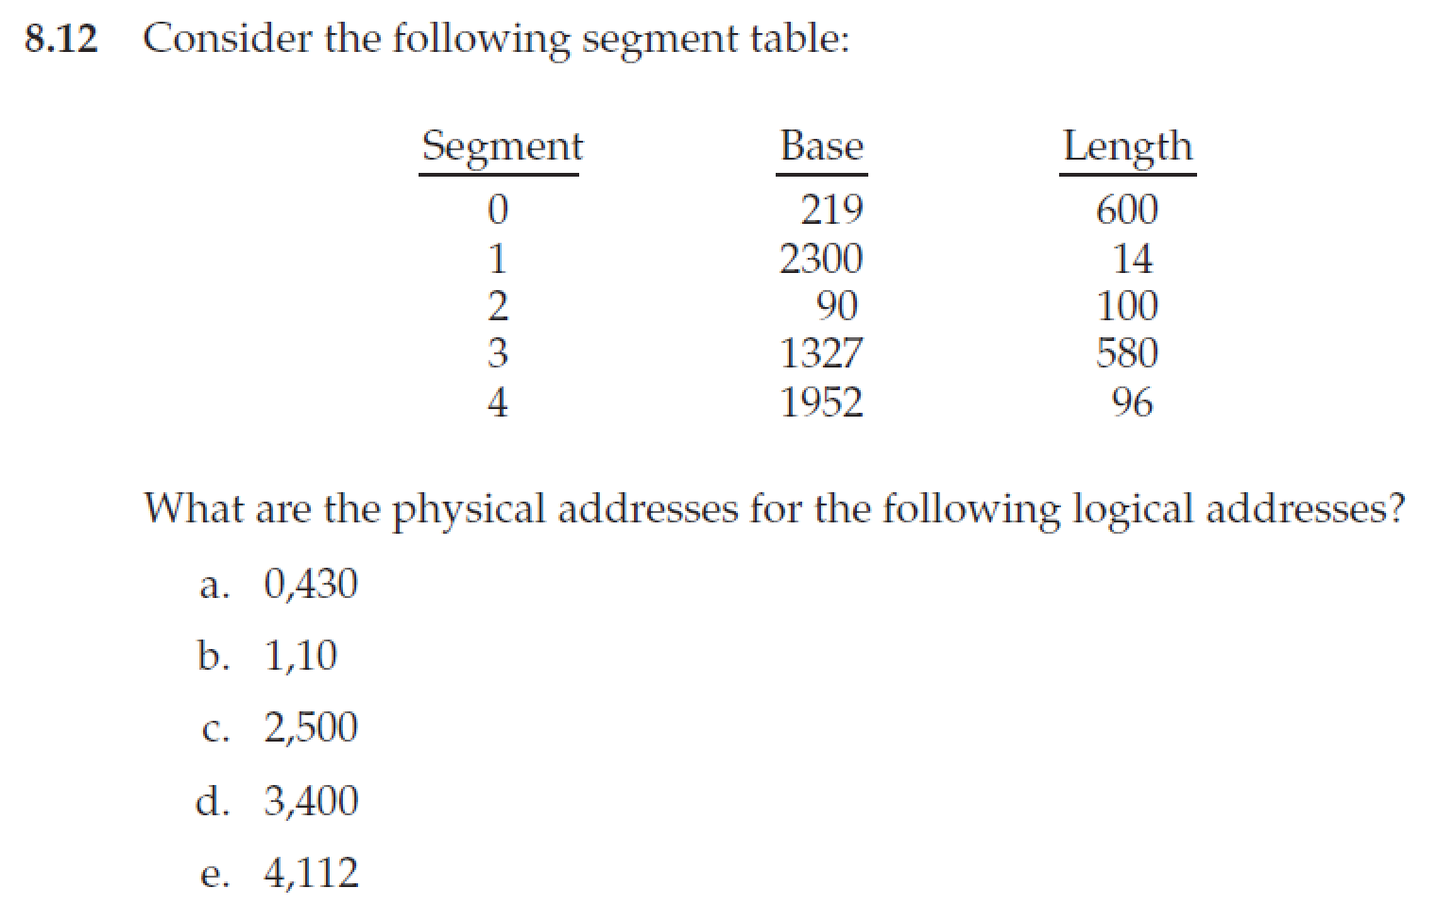
Homework
12月3日晚上12点前提交作业
上传文件时，"名字"填"作业1"、"作业2" 等，"姓氏"请填"个人姓名“
文件名以“学号-姓名-作业x”命名，例如“3170100000-张三-作业1”
有问题可询问TA曾奕久 18888921519 22221190@zju.edu.cn

Slide 84
End of Chapter 8

